Slide 1

DESIGN & ANALYSIS OF ALGORITHMS
Depth-First Search (DFS)
A Fundamental Graph Traversal Algorithm
SM
Presented by: Sahil Mahure PRN-25070521207
Graph Algorithms
Computer Science & Engineering

Slide 2
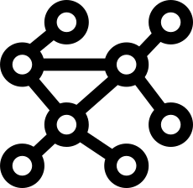
01. Foundation
Introduction to DFS
CORE MECHANICS
Go deep first, then backtrack.
Graph Traversal
Deep Exploration
Stack / Recursion
Graph Versatility
Visits all vertices in a structured graph or tree data structure.
Explores a complete path down to leaf nodes before backtracking.
Implemented using implicit call recursion or explicit Stack frame.
Operates seamlessly on directed and undirected graph structures.

Slide 3

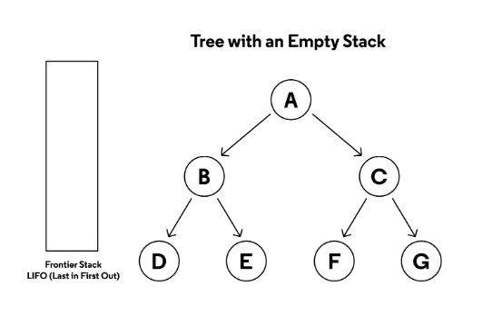
02. Process
Working of DFS
1
Start at root vertex A
2
Visit B, then move deeper to D
3
Backtrack to B and explore unvisited E
4
Backtrack to A, move to C, then explore F
RESULT TRAVERSAL ORDER
A → B → D → E → C → F

Slide 4
03. Implementation
Algorithm & C Program
dfs_algorithm.c
C Language
#include int graph[10][10], visited[10], n; void DFS(int v) { int i; visited[v] = 1; printf("%d ", v); for (i = 0; i < n; i++) { if (graph[v][i] && !visited[i]) { DFS(i); } } } int main() { int i, j, start; scanf("%d", &n); for (i = 0; i < n; i++) for (j = 0; j < n; j++) scanf("%d", &graph[i][j]); scanf("%d", &start); DFS(start); return 0; }
Algorithm Logic
Start: Begin at starting vertex.
Mark Visited: Set visited flag array.
Output: Display processed vertex value.
Recurse: Visit adjacent unvisited nodes.
Backtrack: Return when no neighbors left.

Slide 5
04. Analysis
Execution & Complexity
Sample Execution
INPUT (Adjacency Matrix)
TIME COMPLEXITY
O(V²)
O(V + E)
4
0 1 1 0
1 0 0 1
1 0 0 1
0 1 1 0
Start Vertex: 0
Adjacency Matrix
Adjacency List
SPACE COMPLEXITY
O(V)
Auxiliary space required for tracking visited array and call stack recursion.
GENERATED OUTPUT
0 1 3 2

Slide 6
05. Applications & Summary
Applications & Trade-offs
Key Applications
Advantages
Limitations
• Maze & Path Exploration
• Straightforward implementation
• No shortest path guarantee
• Cycle Detection in Graphs
• Memory-efficient on deep graphs
• Risk of Stack Overflow in deep trees
• Connected Components
• Ideal for decision trees & puzzles
• Can get trapped in infinite loops
• Topological Sorting
• Network Directory Search
Conclusion: DFS is an essential graph algorithm for deep traversal before backtracking.
Thank You!

